Slide 1

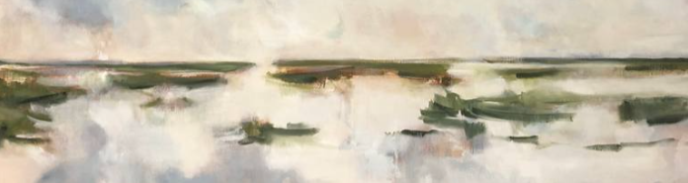

Slide 2
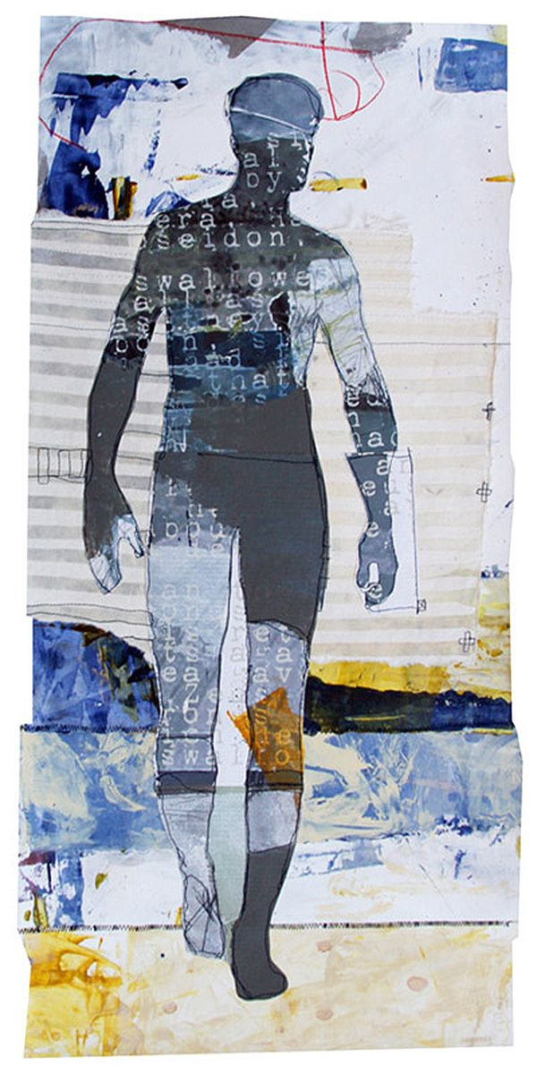
OVERVIEW
Task: Develop and refine one resolved artwork or a small body of work based on your FIA1 experiments
Duration: 5 weeks
Media: Your choice – 2D, 3D, or time-based
Focus: Refine and extend your idea through a selected focus (People, Place or Object) and lens to communicate your viewpoint about connection!
This is a continuation of FIA1 — not a new task
You must submit your own unique and original response

Slide 3

People –
Psychological
Choose a Focus Area
Choose one of the following focus areas to extend into a resolved work:
Select ONE focus from FIA1:
People
Place
Object
Choose the direction that:
was most successful in FIA1
connects strongly to your idea
allows for further development
Apply Your Lens
You must apply a lens:
Literal vs Non-Literal
Objective vs Subjective
Psychological
Your lens determines how your idea is communicated
It should be clearly visible in your final work
Place –
Literal vs Non-Literal
Object –
Objective vs Subjective

Slide 4





Review your FIA1 experimental work
Identify your strongest direction
Select one focus (People, Place or Object) to extend
Identify mentor artists that connect to your idea
Analyse both:
concept (what they explore)
visual language (elements + principles)
Revisit your inquiry question and refine it if needed
Continue experimenting and refining:
Material
Techniques
Composition
mark-making
Create one resolved work OR a small body of work that shows your thinking and skills
Your inquiry question guides your concept.
You are responding to: How can reinterpreting people, places and objects through an artistic lens communicate my viewpoint about connection?
Your artwork is your response to this question

Slide 5
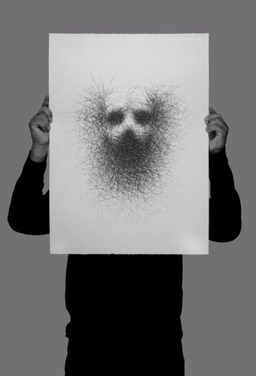
What You Need to Do
Select one focus from FIA1
Apply a clear lens
Refine and develop your idea
Research and apply mentor artists
Create one resolved artwork or body of work
Document your process
Write a 200-word artist statement

Slide 6
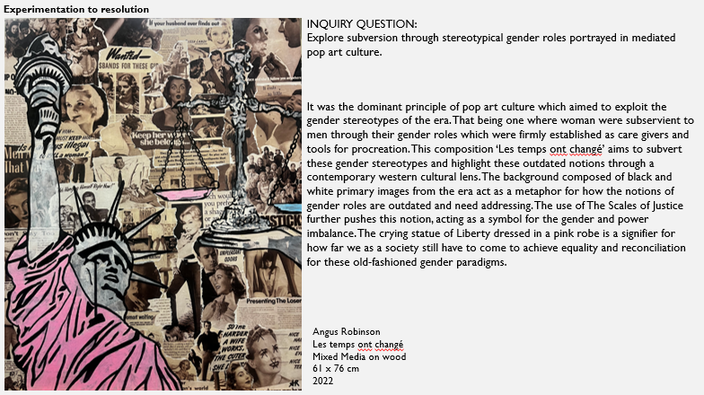
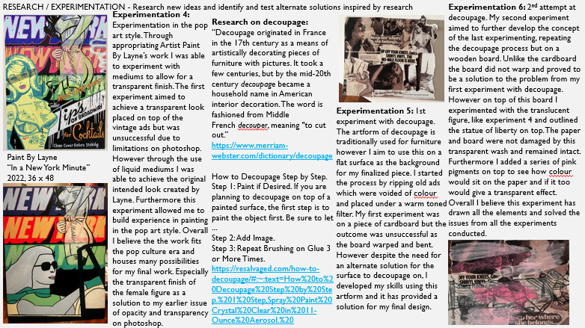
Supporting Evidence (3-4 slides) Show your process across:
DEVELOPING
Key FIA1 experiments
Refinement of ideas, materials and composition
RESEARCHING
Mentor artist connections
Evidence of:
concept (ideas, meaning)
visual language (elements + principles)
Relevant visual stimuli
REFLECTING
Decisions and changes
Challenges and problem-solving
How your idea has developed
RESOLVING
Progress towards final work
Refinement and control of materials
Clear link between idea, artist influence and outcome
Show clear progression: experiment → refinement → resolution
Artist influence must be visible in:
your ideas (concept)
your visual decisions (elements + principles)
Artist Statement & Final Presentation
Write approx. 200 words:
What is your inquiry?
What does your work communicate about connection?
How did your idea develop from FIA1?
How did artists influence your work?
How did you resolve your work using materials?
Include a clear image of your final artwork
Annotate your work showing:
Developing
Researching
Reflecting

Slide 7

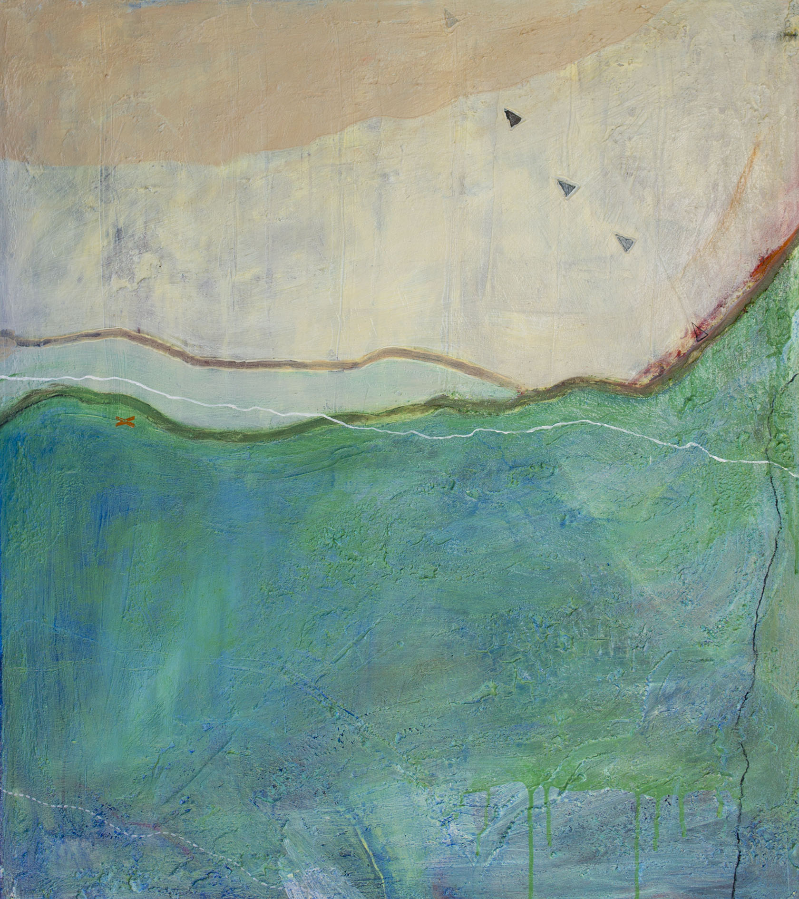
Don’t start again — refine your idea
Keep your focus clear
Make your lens obvious
Push depth, not quantity
Strong work = clear idea + clear lens + connection

